Slide 1
From Data to Design: Enhancing Fuel Decision- Making in Queensland
Team：Chiikawa

Slide 2
Dataset Selection
2024 International Fuel Price
Data
Queensland Government Registered Fuel Station Price Data
Qualitative Data
Gas station reviews on Google Maps
From public market information and energy analysis websites.
From Queensland Government Open Data Portal.
Interview

Slide 3
Data Analysis and Discovery
01
International-Local Correlation
02
Brand Differences
03
Location Impact
Positive correlation between international oil price fluctuations and local price trends.
Price variations between chain brand stations and independent stations.
Highway stations typically charge more than suburban stations.

Slide 4
User Interviews
75%
100%
80%
Compare Prices
Budget Awareness
Uncertainty
Users compare prices across multiple fuel stations
All users need to understand how much fuel their budget can buy.
Users uncertain if they've chosen the most economical station.
"I always struggle deciding between adding a fixed amount or filling up, it's hard to quickly determine which station is more economical" — User A, 32

Slide 5
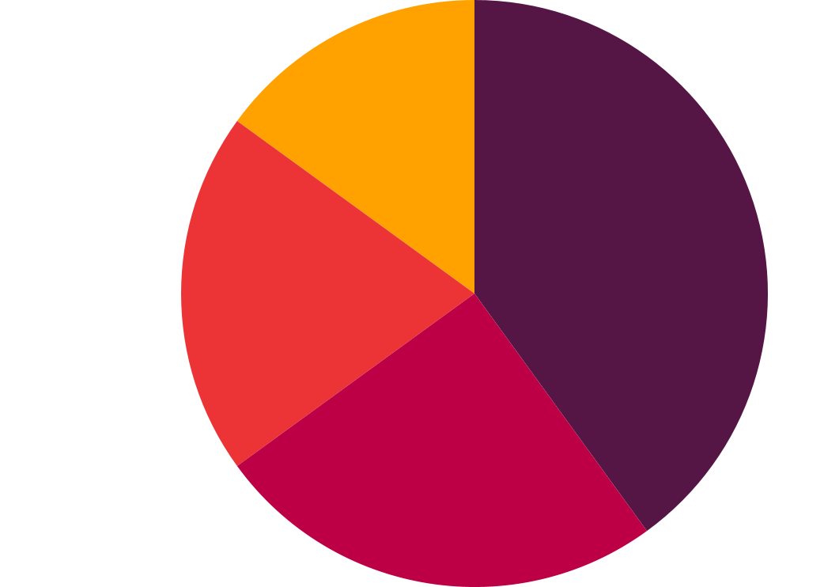
Problems to Solve
Information Dispersion
Unstructured User Experience Data
Consumers lack convenient tools to find the lowest price stations nearby.
User reviews on platforms like Google Maps are unstructured and hard to use.
Information is scattered across different platforms and not integrated.
It’s difficult to evaluate station quality, service, and facilities from fragmented comments.
Lack of Intuitive Comparison
Special Fuel and Service Accessibility Gaps
No intuitive way to know which station offers better value.
Stations offering special fuels (e.g., 98-octane, E10) are not clearly marked or evenly distributed.
Difficult for users to make the most economical choice based on location and fuel type.
Users of specific fuel types struggle to find appropriate stations, especially in remote areas.

Slide 6
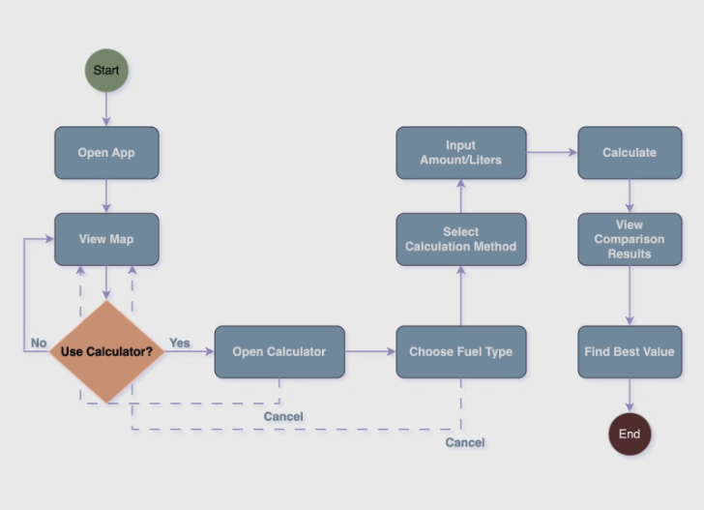
Our Solution
c
Cheap Gas Station Map
Visually displays the cheapest nearby gas stations easily.
F
Fueling Calculator
Enter budget or expected liters to compare values.
P
Price Comparison Tool
Compare price differences between different gas stations.
P
Price Alerts
Notify users when prices drop to set thresholds.

Slide 7
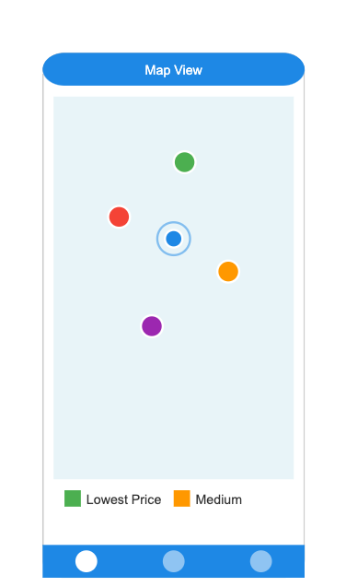
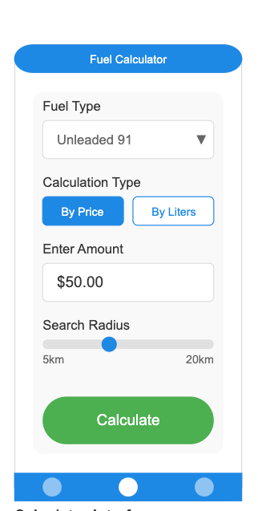
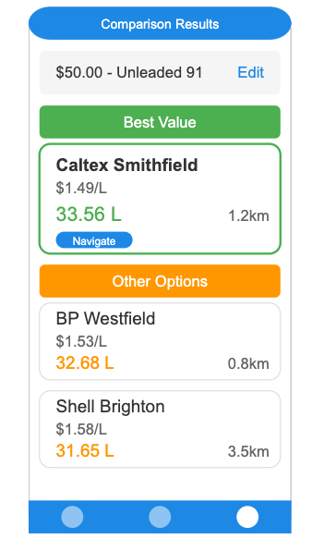
Design Style
Clean and intuitive design, minimizing user input steps with clearly shown price comparisons.
Home Map View
Calculator Interface
Comparison Results
Shows station locations and prices at a glance.
Clean user input screen minimizing steps.
Shows different stations side by side for quick decisions.

Slide 8



Impact and Limitations
Saving Money
Increased Efficiency
Increased Efficiency
5%-10% savings per refueling
Less time finding and
comparing stations
Based on clear data-driven comparisons
Lack of Real-Time Pricing Data
Subjectivity in User Reviews
Incomplete Data on Special Fuel Availability
Government data lacks real-time discount and promotional pricing.
User reviews are unstructured and may introduce subjective bias.
Limited data on special fuel availability in remote areas.

Slide 9
Thanks!

